Slide 1
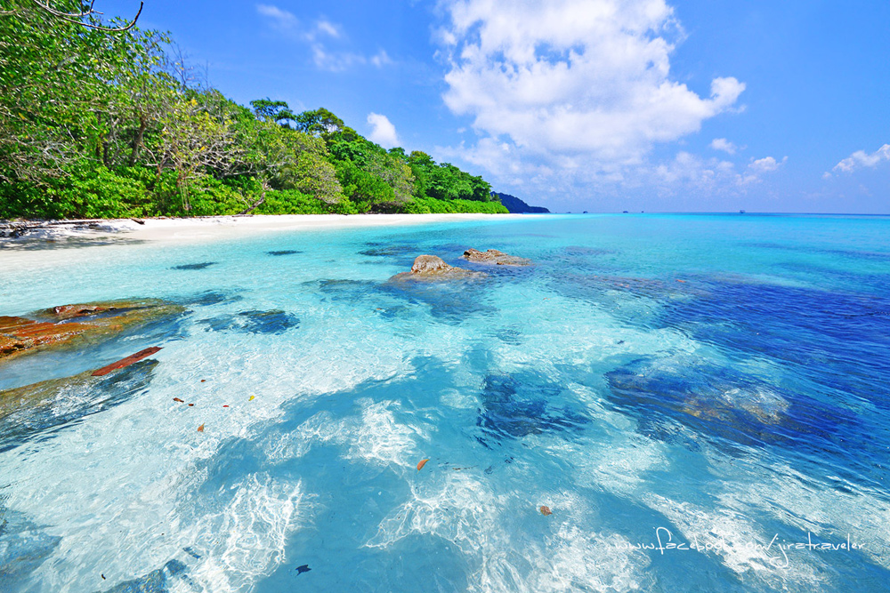

BLUE COLOR

Slide 2
CHAPTER 1
SHADES OF BLUE

Slide 3

BLUE
Health - reliable - flair - loyalty - faith - be it the color of the sky as a symbol of the love of heaven and paradise.
Also blue is also the color of truth, too. It is a color that appears in the sky when the clouds disappear.
The church is blue in color identification Mary. The use of color in the High Holy Days, held to commemorate for an event in the life of her blue is the color that represents stability, uniformity, stability, certainty, strength, leadership, water, cold, clean and comfortable place. trust ... classic
sensibilities mood in China blue means little girl in Iran are meant to be mourning.

Slide 4

LIGHT BLUE
Intuitive - to
- understanding
- patience
– the tenderness

Slide 5

SKY BLUE
The color of peace, trust, honesty, peace and cold help relax and reduce appetite. The heat in the body and mind. If you dress in blue sea and red lipstick. To Luke girl hot credible.

Slide 6

Aqua BLUE
Protection - health

Slide 7

Dark Blue
the truth
power
knowledge
integrity
protection.

Slide 8
CHAPTER 2
BLUE SHADE IN FILM

Slide 9
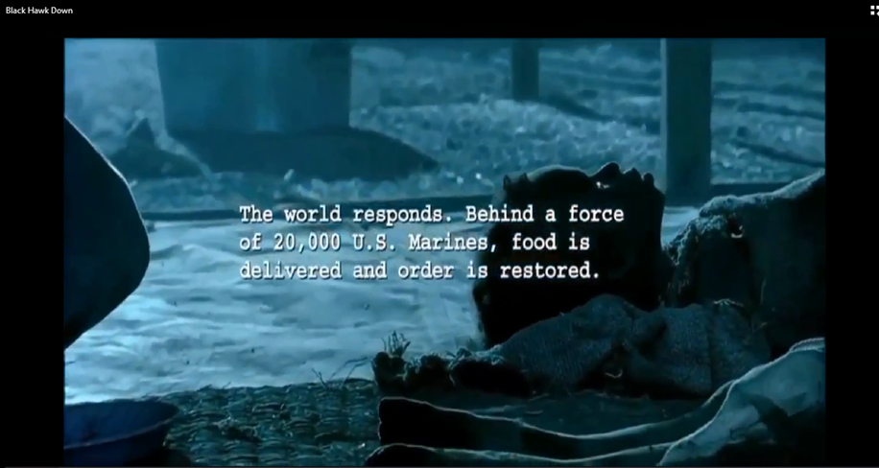
Black Hawk Down
In this scene to convey to death bleak.
Die slowly in the social life in the war

Slide 10
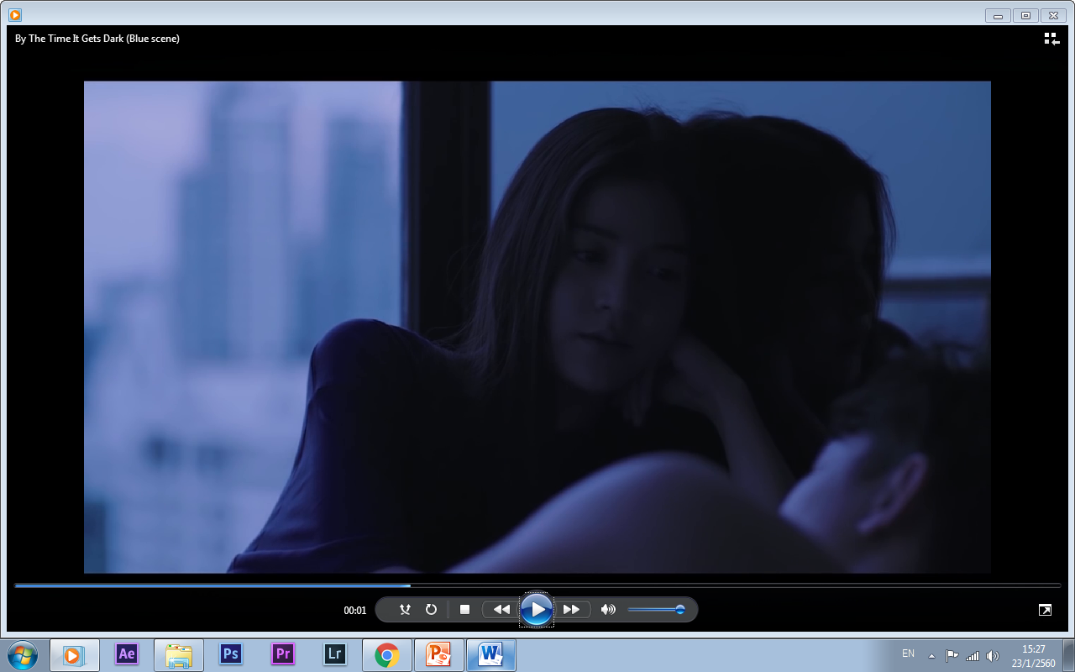
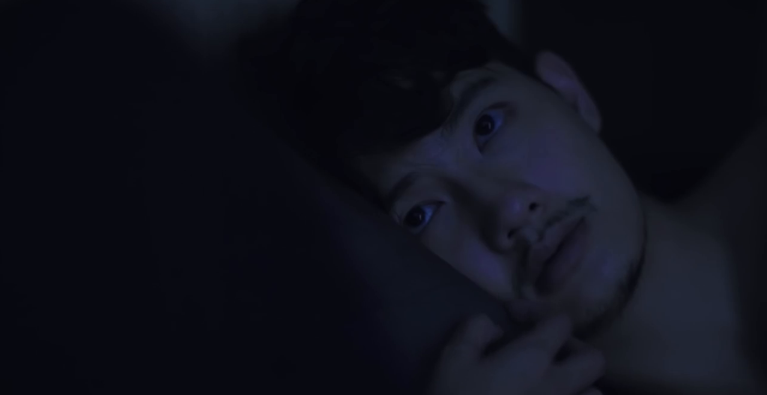
By The Time It Gets Dark
(Dao-ka-nong)
In this scene the characters met eye
and color atmosphere is blue.
To convey the love that cold, shifting back and forth

Slide 11
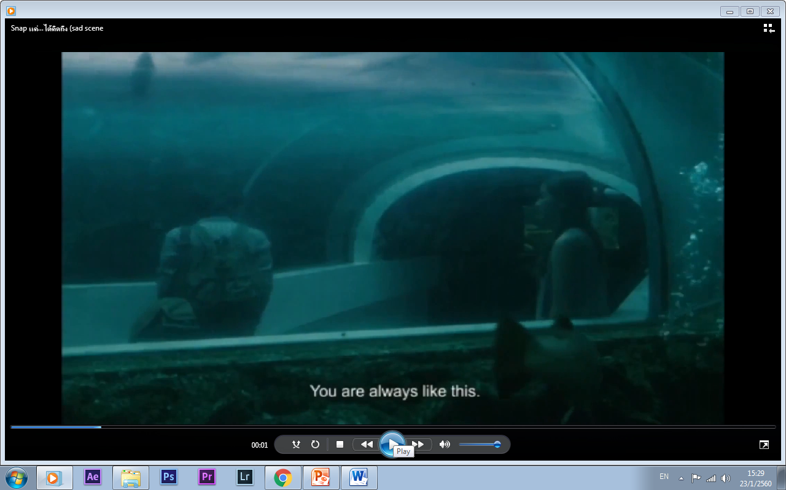
Snap แค่…ได้คิดถึง
In this scene the characters are in a sad mood,
both men are like fish swimming in the water.

Slide 12
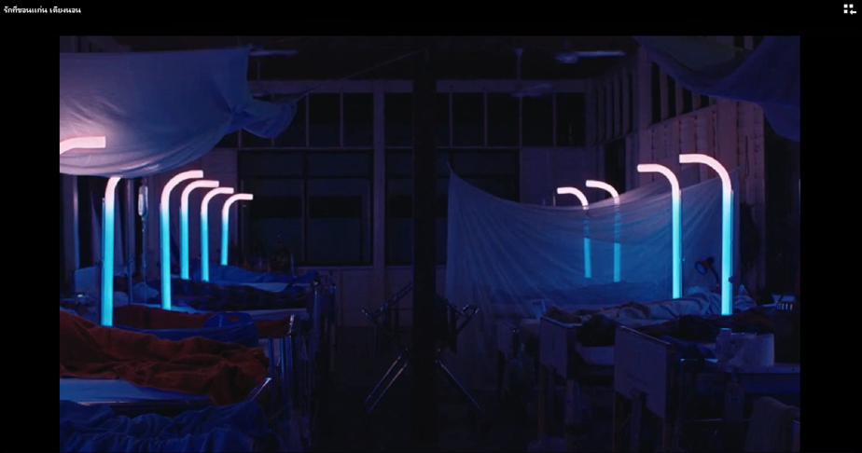
CEMETERY OF SPLENDOR
In this scene represents
the slumbering people

Slide 13
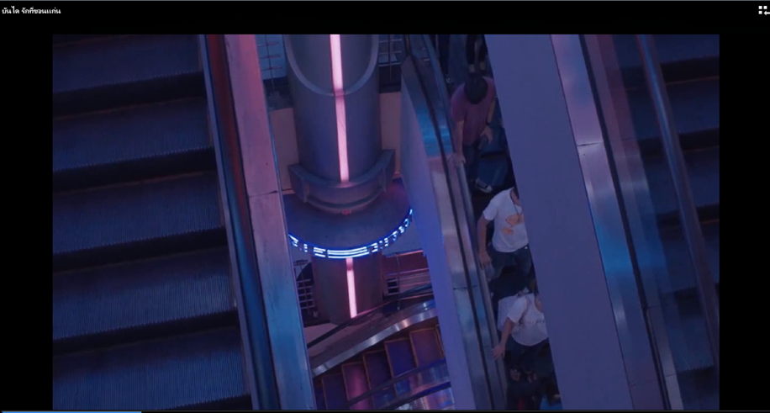
Cemetery of Splendor
And as the deep sleeps, never end.

Slide 14
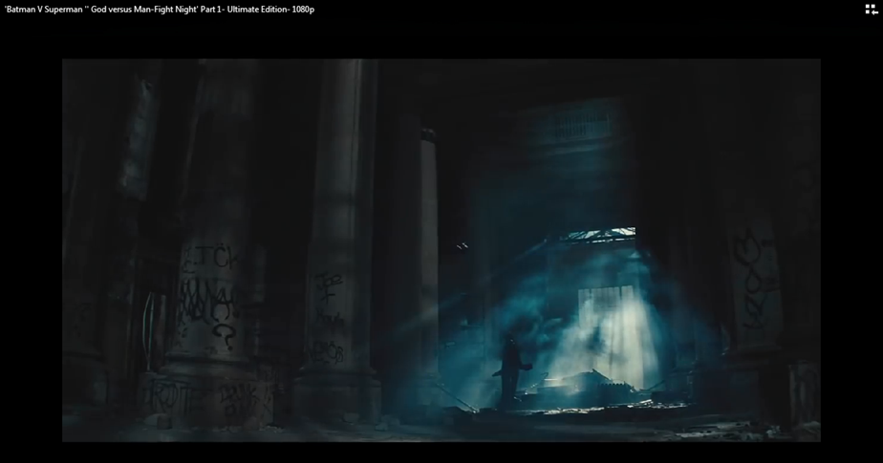
'Batman V Superman ''
God versus Man-Fight Night
This is a scene in the BVS blue light from the outside come splashed into to the bleak tamaen brands that intend to fight against Superman.

Slide 15
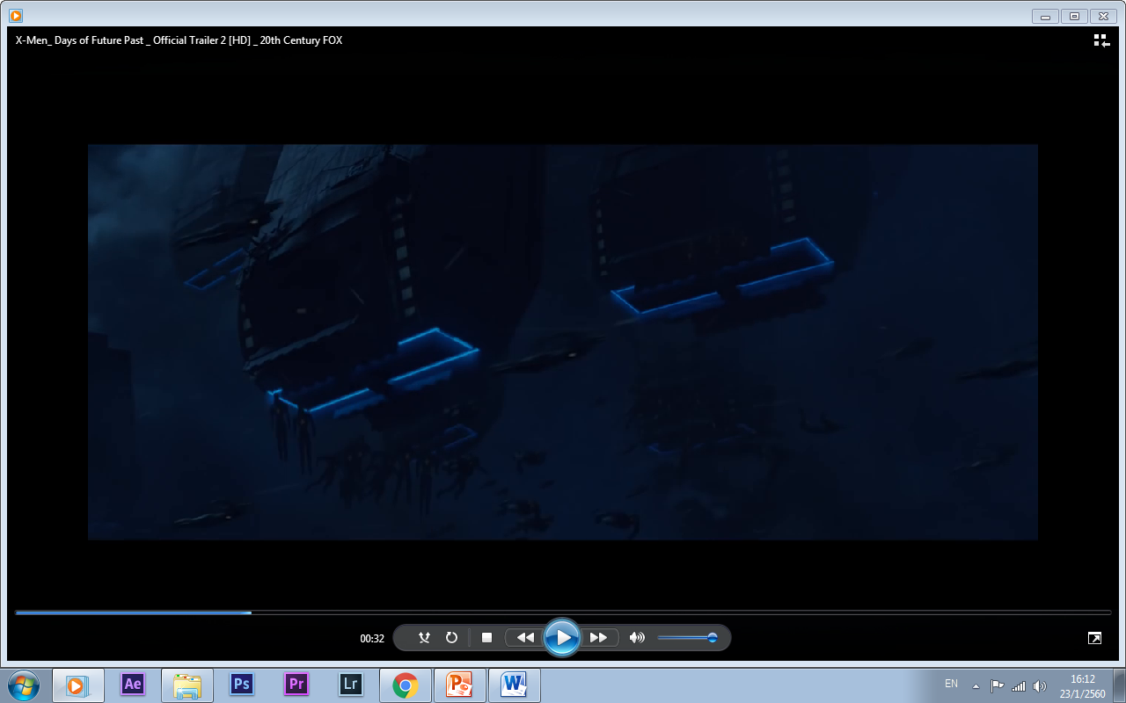
X-MEN_ DAY OF FUTURE PAST
The scene of the X-men using
color dark blue to reflect the power of the army.

Slide 16
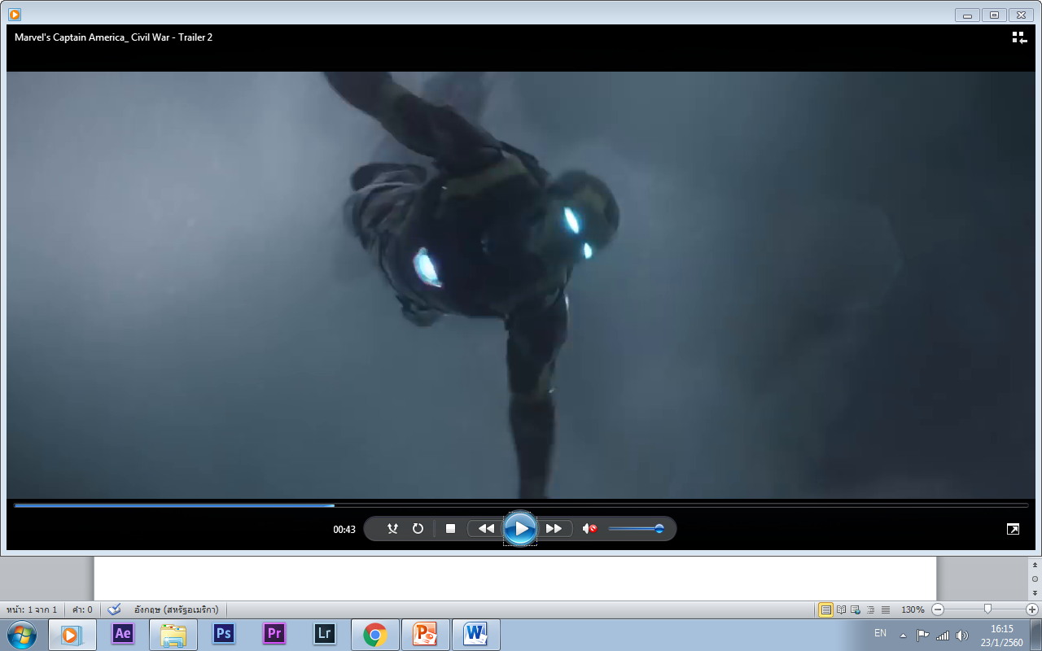
MARVEL’S CAPTAIN AMERICAN_ CIVIL WAR
the scene of Captain America Civil wars blue sky,
half of the show is the crux of the Iron man in mind.

Slide 17
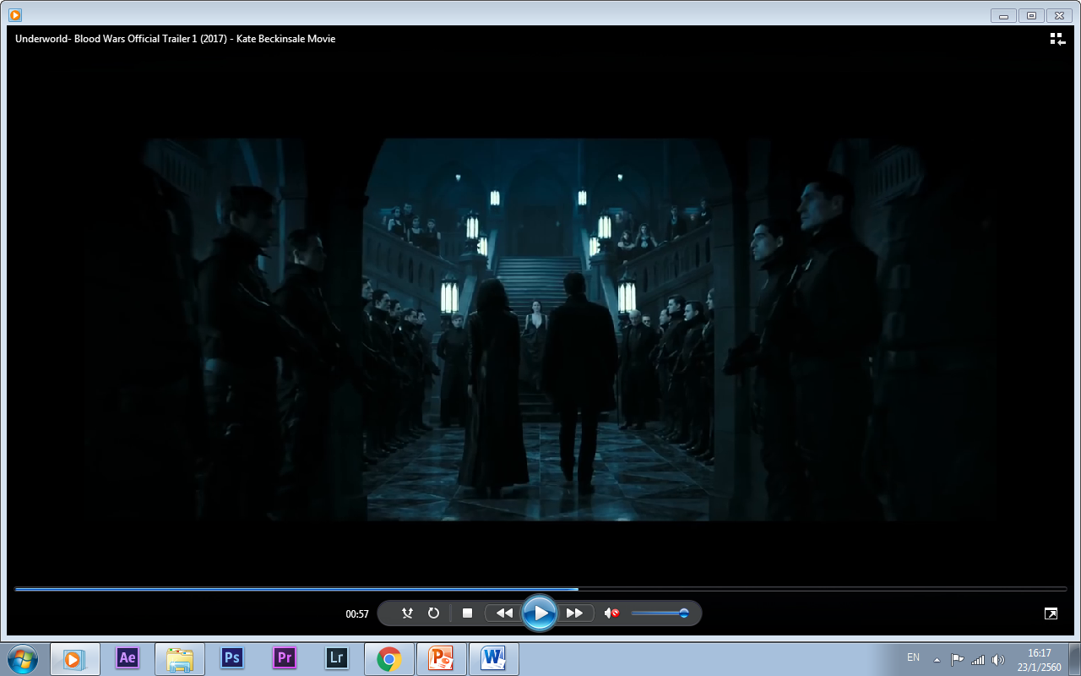
UNDER WORLD- BLOODS WARS
Underworld in this scene is the heroine and hero went to influential vampire can be seen that the Blue Jay to have a fear of the power of Ram.

Slide 18
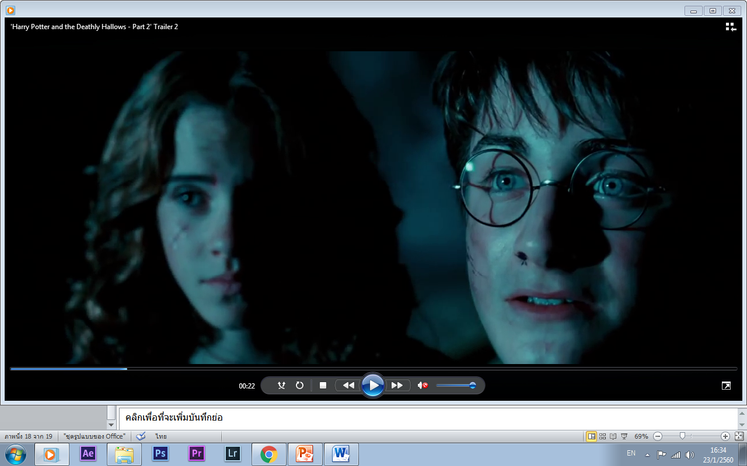
HARRY POTTER AND THE DEATHLY HALLOWS
This scene is that Harry decided to put himself to
the lord voldermor killed by the use of blue to see the truth,
to protect the right to believe in goodness.

Slide 19
END

