Slide 1
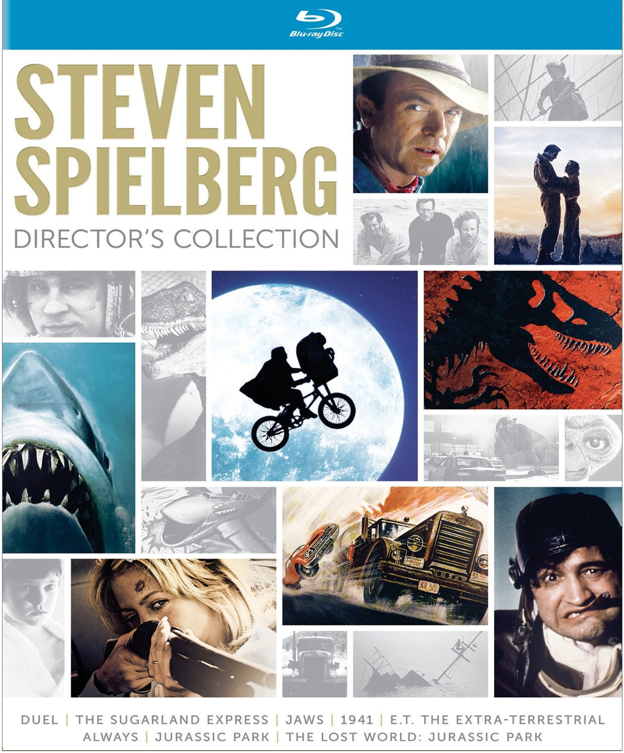

Slide 2
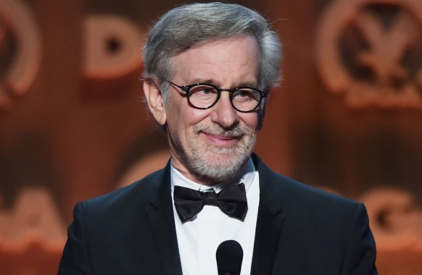
Steven Allan Spielberg
KBE OMRI (born December 18, 1946) is an American director, producer and screenwriter. Spielberg is considered as one of the founding pioneers of the New Hollywood era, as well as being viewed as one of the most popular directors and producers in film history. He is one of the co-founders of DreamWorks Studios.

Slide 3
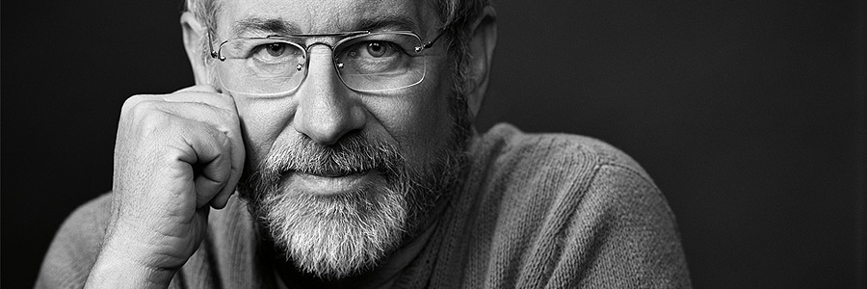
Film
Techniques

Slide 4
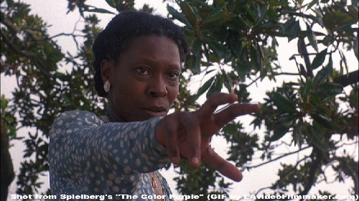
1. Track-in shots
In this type of shot the camera physically moves in on the subject, typically going from a medium close-up to a tighter close-up. The movement is smooth, the background is blurred, and it is typically used to draw attention to a significant moment in a character’s story. There are many examples of this shot in Steven Spielberg’s films – here is a classic example from “The Color Purple”:
This track-in shot uses a lens of moderate focal length — it looks like 85mm or 100mm.

Slide 5
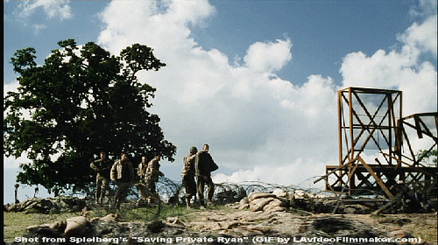
2. Sideways tracking shots
Moving the camera sideways is one of the classic filmmaking techniques, but Steven Spielberg always adds tremendous value to it and makes his tracking shots look absolutely distinct from everyone else’s. His sideways tracking shots can be very long, typically tracking with two characters who are walking and talking. Spielberg adds considerable visual texture to the shots by putting all manner of objects and extras between the camera and the two main subjects, to enhance the richness of the frame and the visual perception of movement.
Again, there are numerous examples of this shot in Steven Spielberg’s films. The example below is from “Saving Private Ryan”:

Slide 6
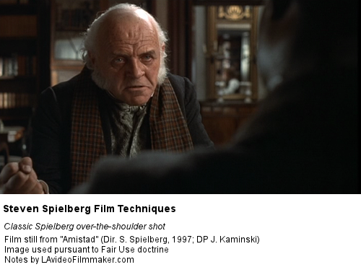
3. Dramatic over-the-shoulder shots
Like the other film techniques in this list, over-the-shoulder shots are very common, but the over-the-shoulder shots filmed by Steven Spielberg are truly something else. He typically films a character over the shoulder of the protagonist using a wide lens, which makes the protagonist in the foreground look much bigger than the other character, conveying a feeling of dominance. It works like a charm.
There are lots of these over-the-shoulder shots in all of Steven Spielberg’s films. The example below is from “Amistad”:

Slide 7
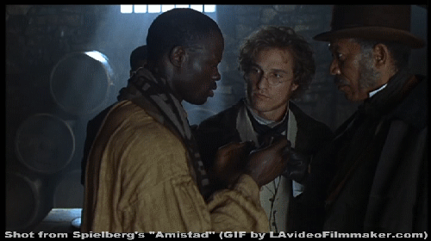
4. Character approaches the camera to be framed in a closeup
Spielberg is not the only director who uses this technique, but he is the best at it by far.
An example from Amistad:

Slide 8
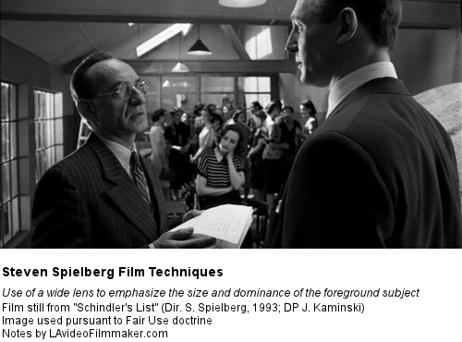
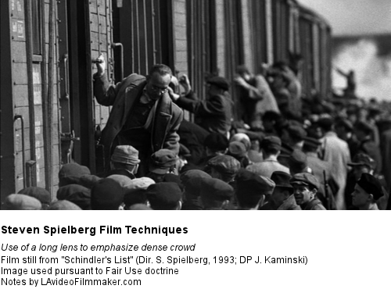
5. Wide lenses
Steven Spielberg loves wide lenses, and he uses them to film tracking shots, over-the-shoulder shots, close-ups, and any other shot in which he wants to make the foreground subject dominate the background. He can be very bold in his use of wide lenses, much bolder than most other filmmakers, which is sweetly ironic, given that he is so frequently (and unfairly) accused of always playing it safe. I think you will find that Steven Spielberg is actually one of the most ambitious, risk-taking filmmakers in the whole history of cinema.

Slide 9
6. Framing characters through rich foreground objects
Steven Spielberg loves to frame characters through openings created by all sorts of objects.
Some of my favourite examples of this film technique:
– In the opening sequence of “Minority Report”, a young boy is framed through a chair in the foreground. It gives the shot an extremely intimate feel, as if you were spying from a hiding place. But there is more to it than that – this technique is made powerful by the fact that framing a character through an opening created by foreground objects really tends to focus our attention on that character. It is much more visually compelling than using a “clean” frame with no foreground objects.

Slide 10
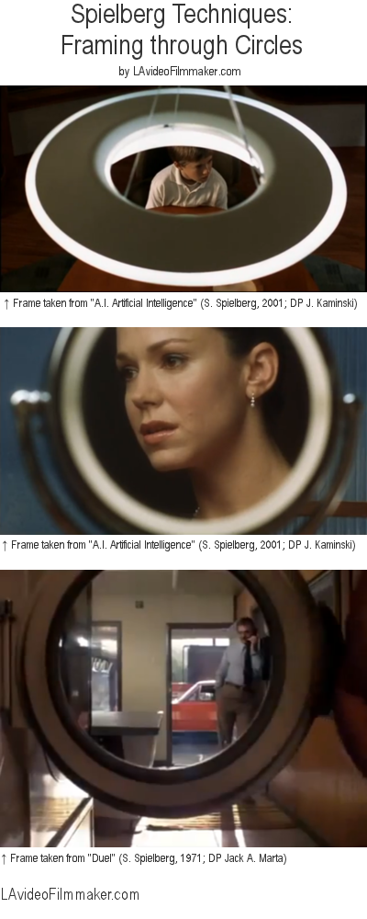
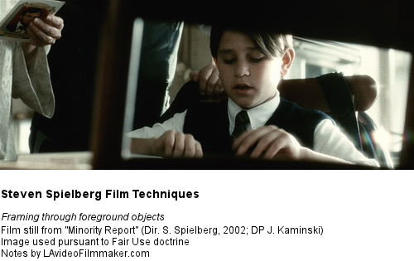
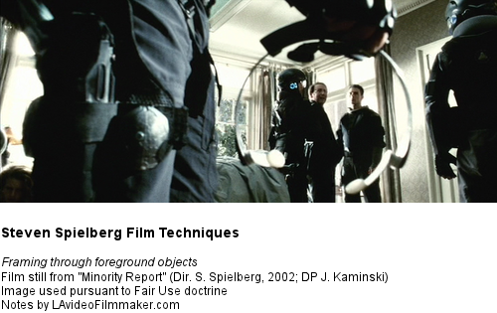

Slide 11
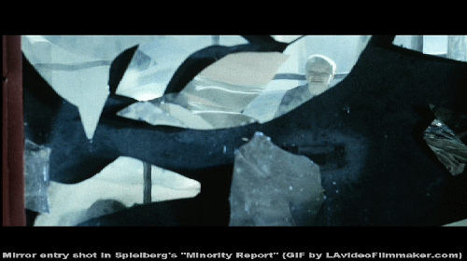
7. Mirror entry shots
In this technique the camera frames a character reflected in a mirror in a wide shot; the character then enters the frame, resulting in a close-up. It is a very effective way to shift from a wide shot to a tighter shot of the same character, all in one uncut shot. The following example is from Spielberg’s “Minority Report”:

Slide 12
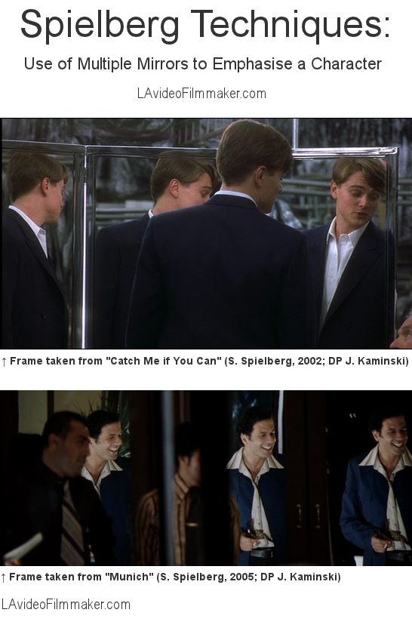
8. Use of mirrors to emphasise a character

Slide 13
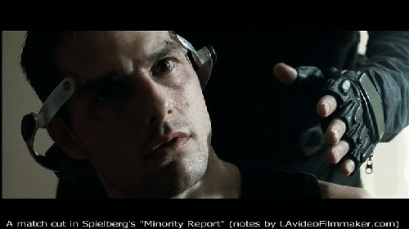
9. Match cuts
Spielberg uses match cuts to great effect. As the name implies, in a match cut an element in the second shot matches an element in the first shot. The example below is taken from Minority Report:

Slide 14
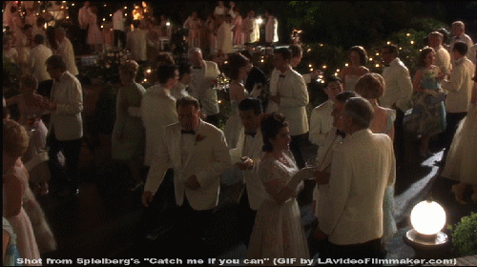
10. Uncut master shots with varied shot compositions
The last film technique in this list is absolutely the hallmark of Steven Spielberg and I have never seen any other filmmaker even come close to using it so well (or at all).
Steven Spielberg sometimes covers multiple-character scenes with a single, uncut shot in which the camera and the actors move in such a way that the shot goes from a wide shot to a close-up to an over-the-shoulder back to a wide shot, ending on a close-up – all in a single uncut shot while the actors move, talk and do things.
The following example is from Catch Me If You Can:

Slide 15
Reference
http://www.lavideofilmmaker.com/filmmaking/steven-spielberg-film-techniques.html
https://www.youtube.com/watch?v=oE4jZ7VvZ3o

Slide 16
Presented By
58129301003 Rutchana Buasri
5829301007 Phongsak Neanruangsang
58129301013 Wisaithas Phoosiri

